Slide 1
Hotel Booking Prediction
RAGHAV KANI K
August 2022

Slide 2
Outline
Scope and Goals
Specification, Hypotheses, Visualization
Derived Insights
Preliminary Insights
Core Insight
Links for Code
Conclusion

Slide 3
Scope
The scope of the project is to categorize whether a consumer will cancel a reservation or not.
The machine learning method was used for this project.
This is accomplished by data preparation, Spatial Analysis, encoding, EDA, splitting the data collection, and model building.
Python is used in this project for the visualization.
We concluded data about the price per night, peak visitor months, average length of stay, and other factors.
In order to determine which algorithms are the best, we also have an automated model.

Slide 4
Goals
The project's objective is to categorize the types of customers that reserve rooms at hotels and resorts using historical data.
Through a variety of algorithms, we can determine the best one to employ in determining if a consumer will book or cancel a room, Guests pay for a room per night.
We can also determine which season or month and which country have the highest customer ratios.
The project's outcome allowed us to predict if a room will be reserved or cancelled using a flawless model.

Slide 5
Specification, Hypotheses, Visualization
The goal of the project is to determine if a customer would reserve a hotel or cancel their reservation using the best model. To speed up the process, we have automated the ML models to discover the best model.
The project's hypotheses call for using historical data analysis to identify customers as children, adults, or newborns. And in order to determine the optimal score, we performed preprocessing, EDA, visualization of the filtered data, and used ML model.
In this project, we also evaluated and visualized the entire data frame, which included information on how much adults, kids, and other visitors paid per night for a room.
The analyzed, preprocessed data are visualized using Matplot & Seaborn.

Slide 6
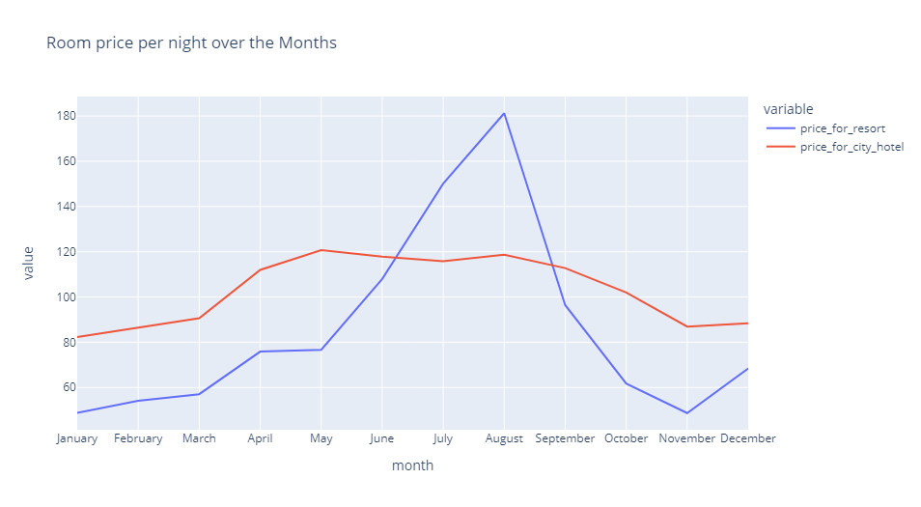
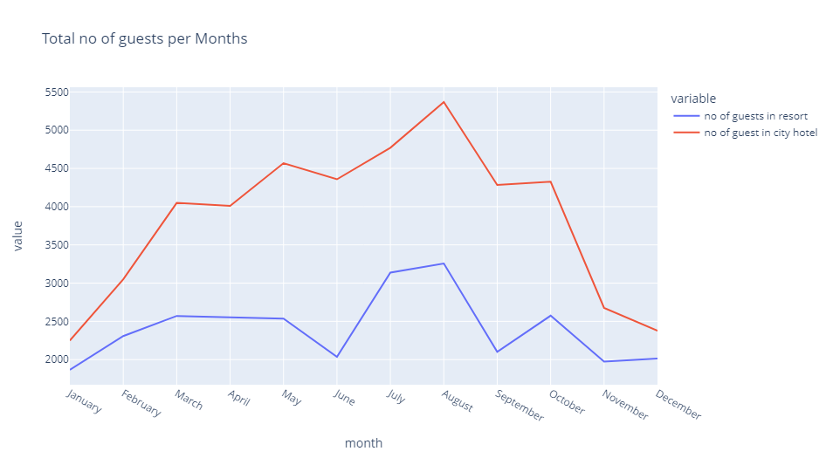
Visualization

Slide 7
Derived Insights
Preliminary Insights
Core Insight

Slide 8
Preliminary Insights
The project's preliminary insights focus on predicting whether the consumer will reserve or cancel a room. To find the best accuracy, a machine learning model is used to make the forecast.
We have also used existing data to extract fresh data after preprocessing, analyzing, and other steps.
To utilize Python for prediction, analysis, data preprocessing, etc., we import the necessary libraries.
We have also discovered things like Did how long do guests spend at hotels, which months are busy, How much do guests pay every night, and so forth.

Slide 9
Core Insight
The project's core insight is to assess and forecast whether a customer would book or cancel a room using the appropriate model to determine accuracy.
As an illustration, using the ML model, we can determine whether a new consumer will reserve a room at a hotel or not.
We have performed EDA, outlier analysis, data pretreatment, model development, and more. These are done using historical data for forecasting.

Slide 10
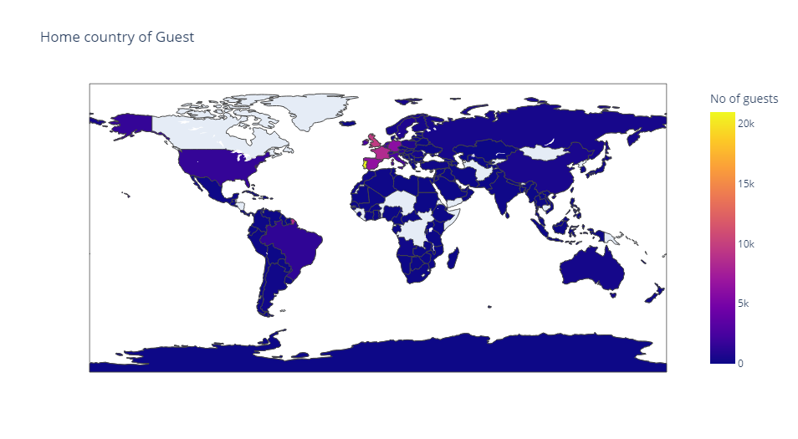
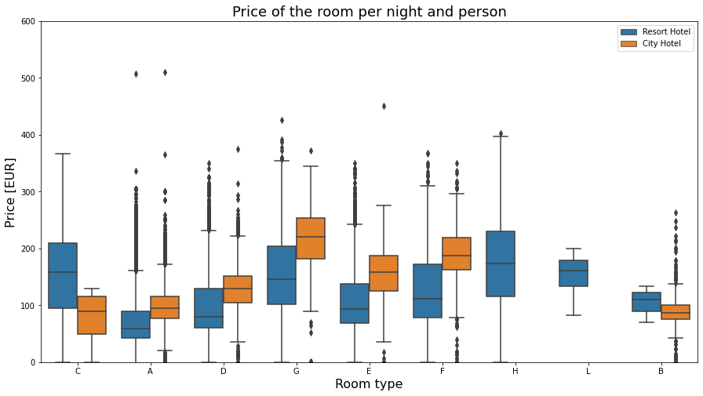
Visualization

Slide 11
Links for Code
Code “Github”, Click – URL
Data Link:-
Spreadsheet ‘Hotel Booking’ , Click – URL

Slide 12
Conclusion
What did we performed in this project?
Python was used for this project, along with the import of libraries and other necessary procedures to finish this forecast.
Import libraries, data outlook, data pretreatment, analysis, visualization, encoding, handling outliers, feature importance, dataset splitting, and model building are the steps.
Using spatial analysis and other data analysis techniques, visualize the full dataset to improve understanding.
Preprocessing includes actions like removing NULL values and outliers.
In the analysis, we have derive the guest's residence, the cost of a room per night, how the cost changes throughout the year, and so forth.

